Slide 1
Agenda
Understanding the basis of Source Separation via an intuitive example-driven approach
Discussion of experiment design
Graph Blind Source Separation
Graph Blind Source Separation results
Summary of major outcomes
Problems and future research

Slide 2
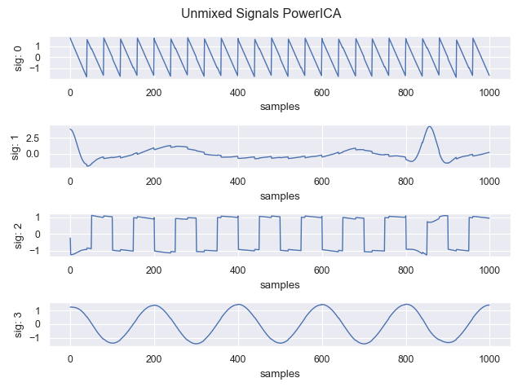
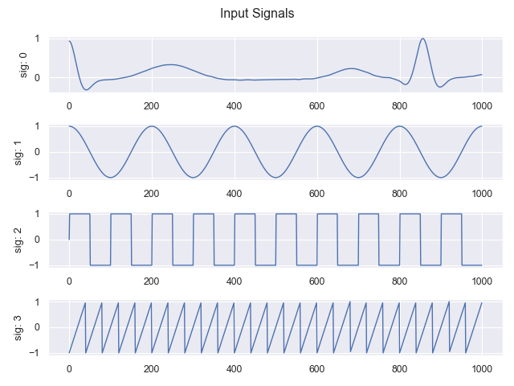
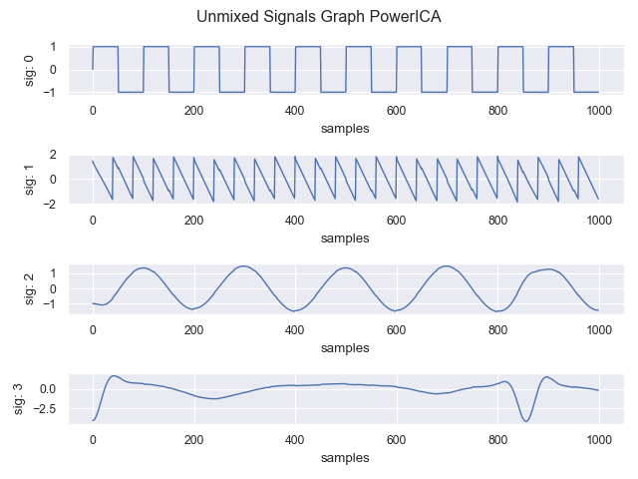
Graph BSS Results Clean data
Standard signals (Cos, Rect, ECG, Saw)
Clean data: Better results than standard Power ICA (1000 samples)
Power ICA
Input signals
Graph Power ICA

Slide 3
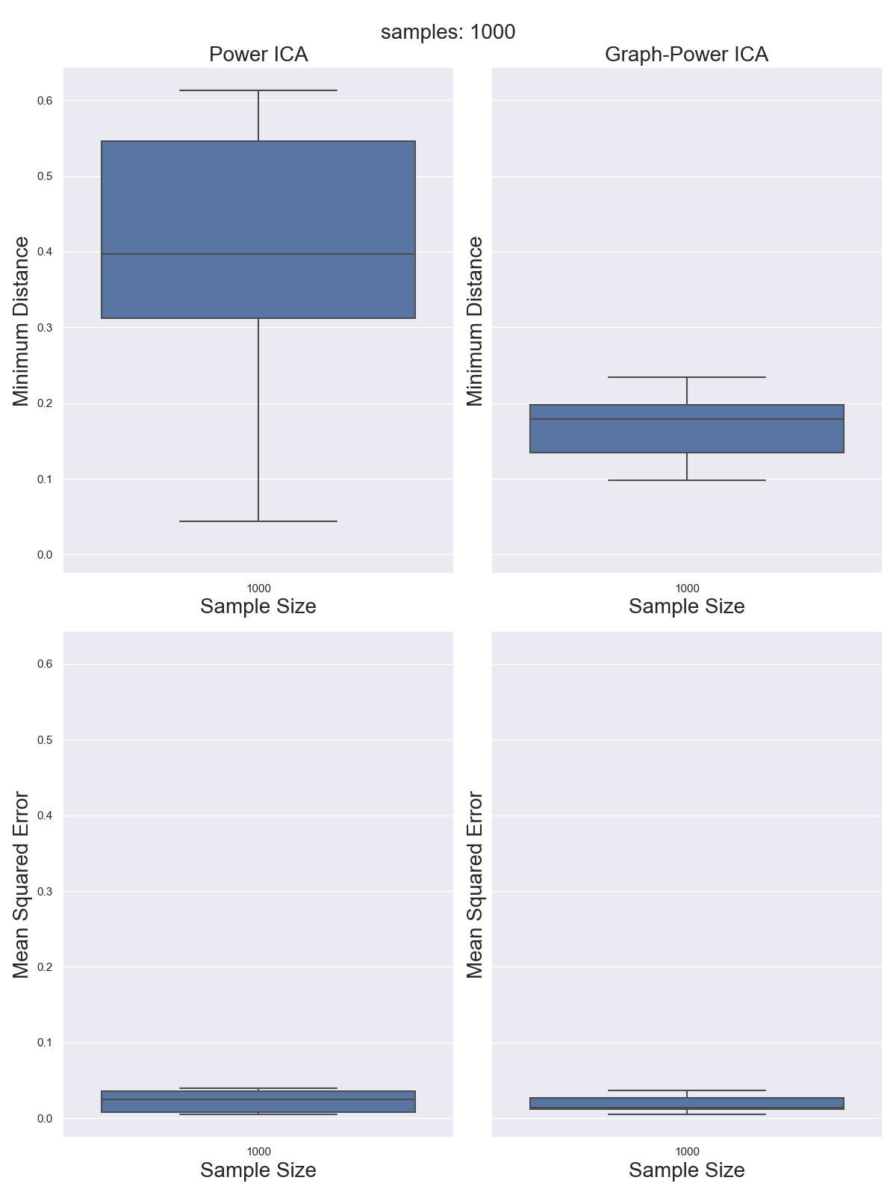
Graph BSS Results Clean data
Standard signals (Cos, Rect, ECG, Saw)
Clean data: Better results than standard Power ICA (1000 samples)
Power ICA
Graph Power ICA
0,6
0,4
MD
0,19
0,1
0,6
MSE
0,1

Slide 4
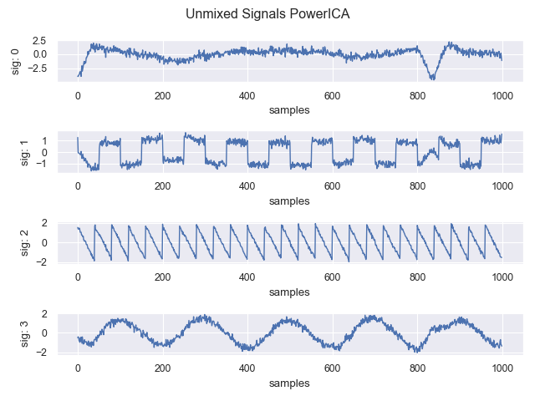
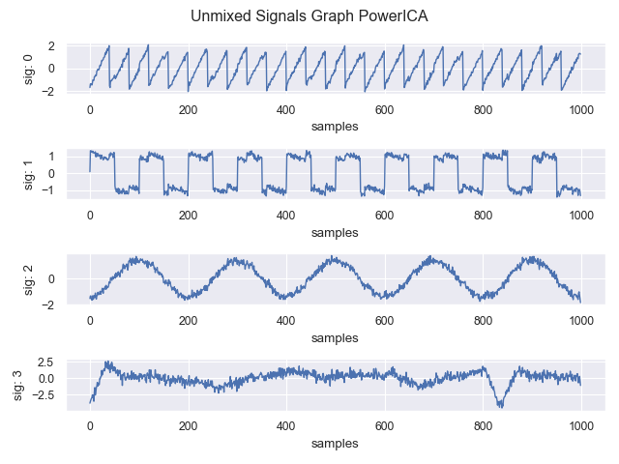
Graph BSS Results Noisy data
Power ICA
Comparable for noisy signals (up to 20dB SNR)
Input signals
Graph Power ICA

Slide 5
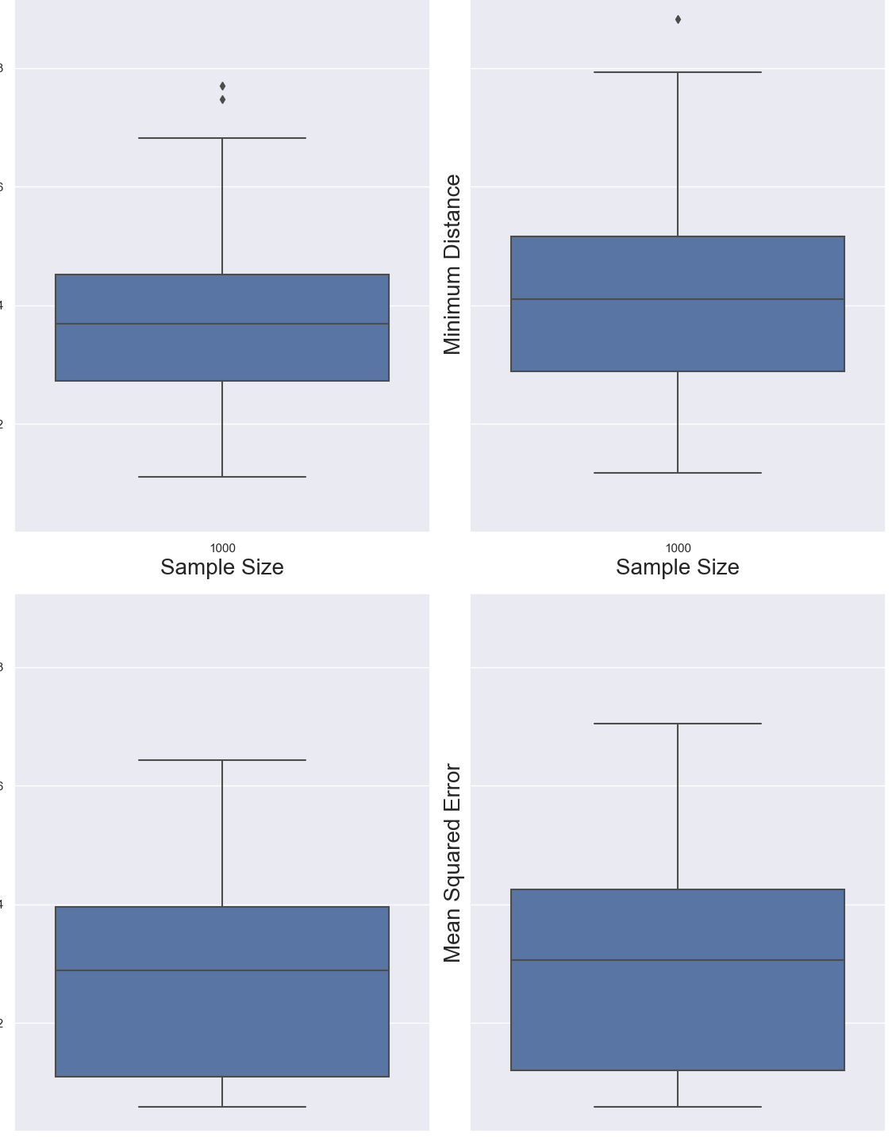
Graph BSS Results Noisy data
Comparable for noisy signals (up to 20dB SNR)
Power ICA
Graph Power ICA
0,8
MD
0,38
0,2
0,8
MSE
0,2

Slide 6
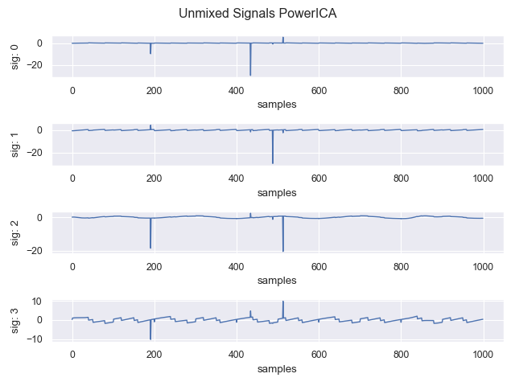
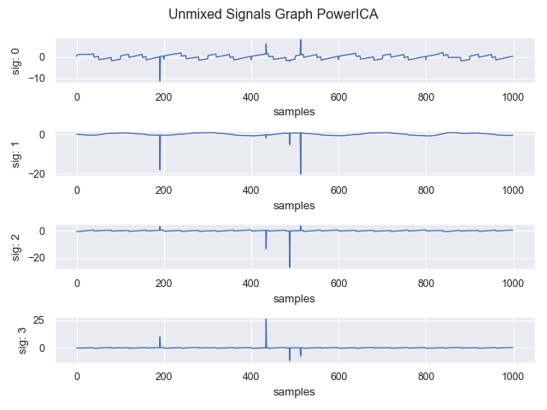
Graph BSS Results Outlier contamination
Breakdown point already with one large outlier (100std)
Power ICA
Input signals
Graph Power ICA

Slide 7
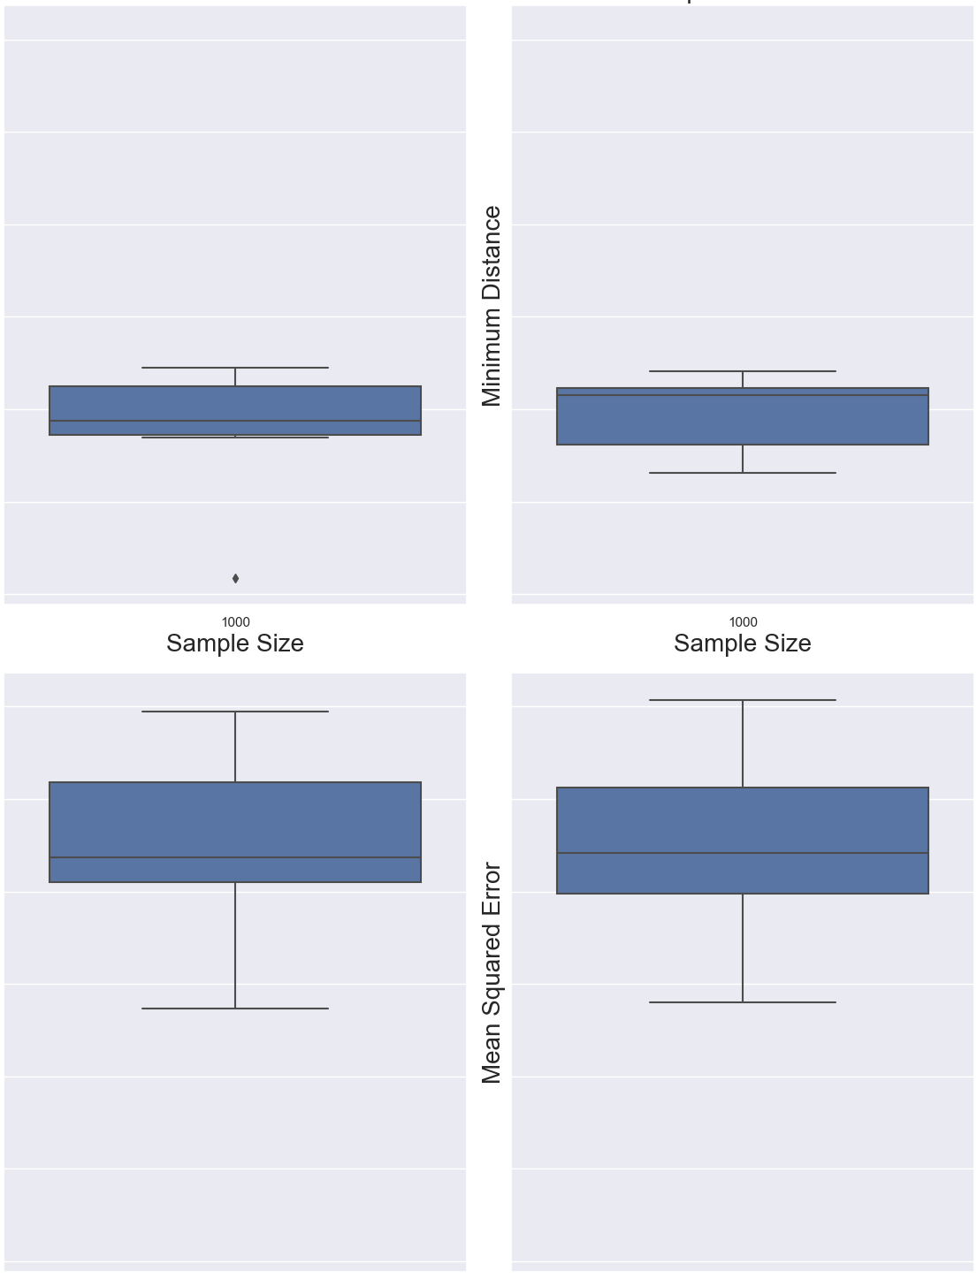
Graph BSS Results Outlier contamination
Breakdown point already with one large outlier (100std)
Power ICA
Graph Power ICA
1,0
MD
0,8
0,4
1,4
MSE
0,4

Slide 8
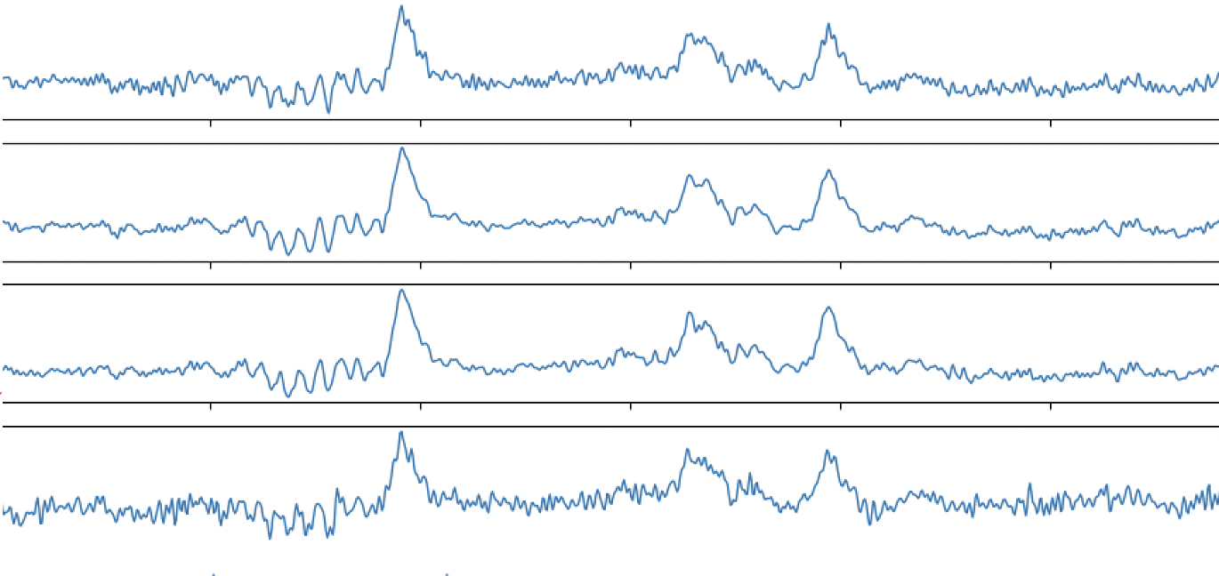
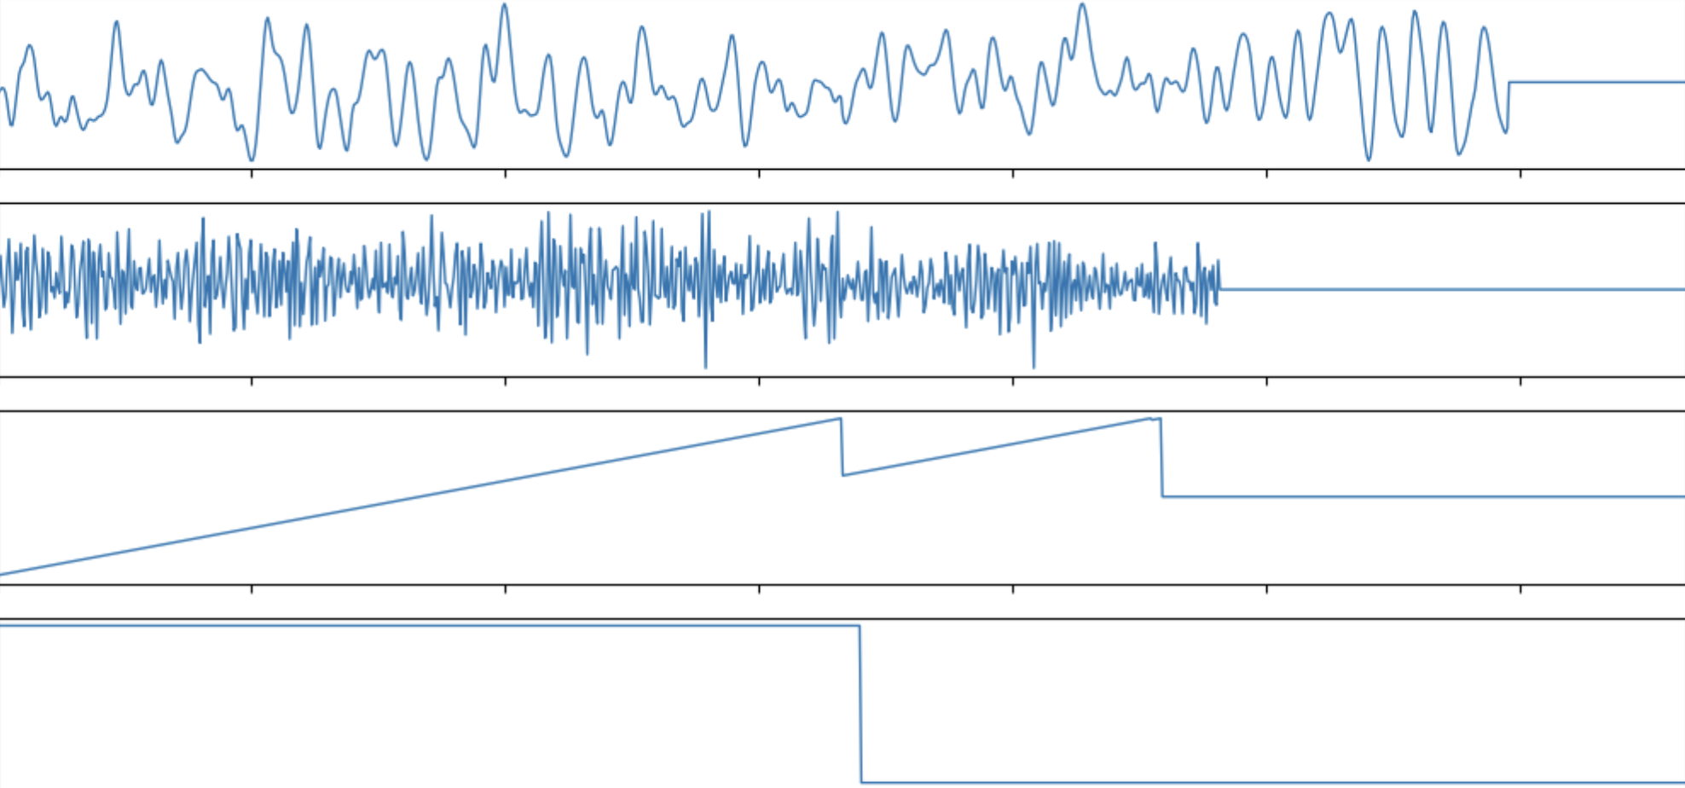
Towards EEG data Synthetic EEG artifact reconstruction
Semi-synthetic EEG data:
1. Use real EEG data as input signals
EEG data:
2. Mix Data with random mixing matrix
3. We generated realistic artifacts and added one on each channel
Artifacts which typically come along with EEG data [Delorme2006]
Optional: Add single or patchy (1000std) Outliers and white noise (3std)
Synthetic EEG artifacts:
Eye Blink
Muscle
4. Perform Power ICA and Graph Power ICA
Electrical
Electrical
Notes:
Show reconstructed artifacts

Slide 9
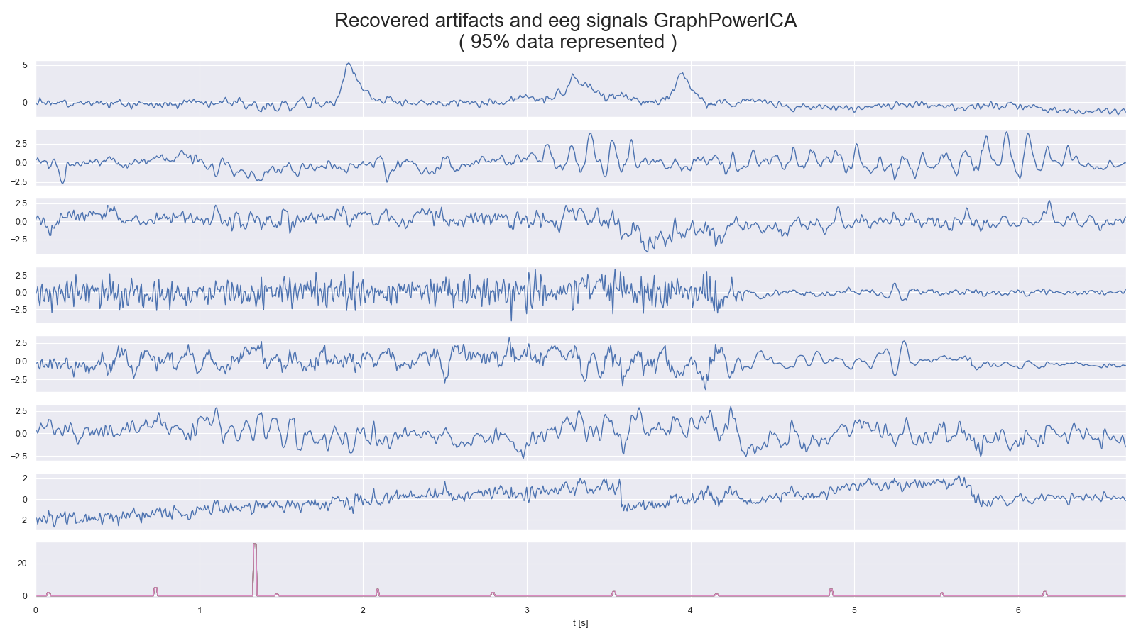
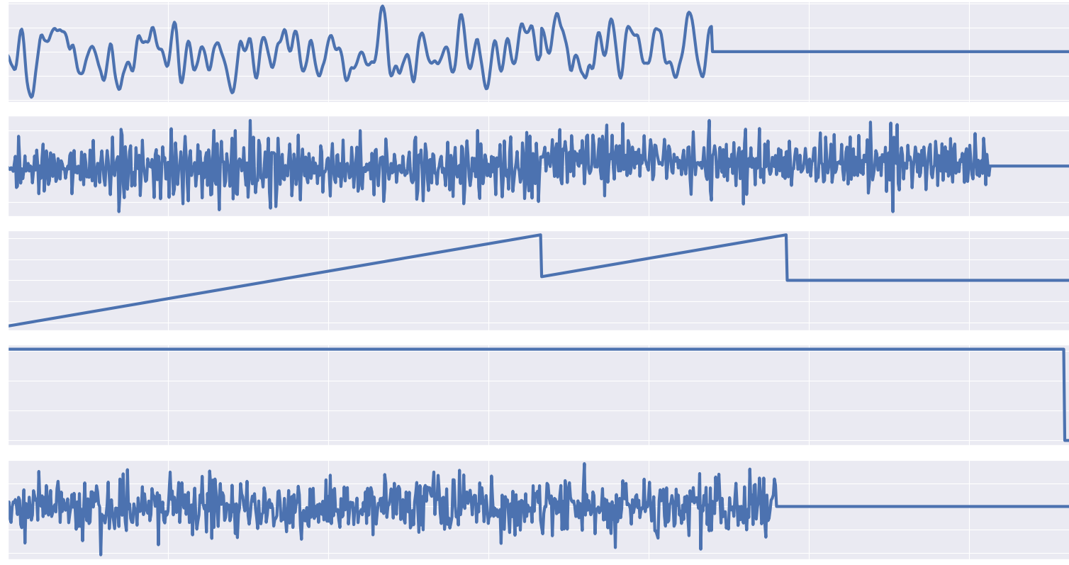
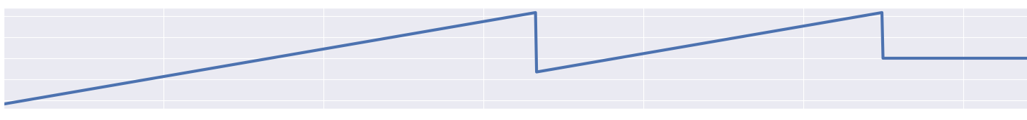
Graph BSS Results Semi-synthetic EEG data
Artifacts clearly extractable:
Power ICA
EEG artifacts
Eye Blink
Muscle
Electrical
Electrical
Noise
0
1
2
3
4
5
6
0
1
2
3
4
5
6
t[s]
t[s]

Slide 10
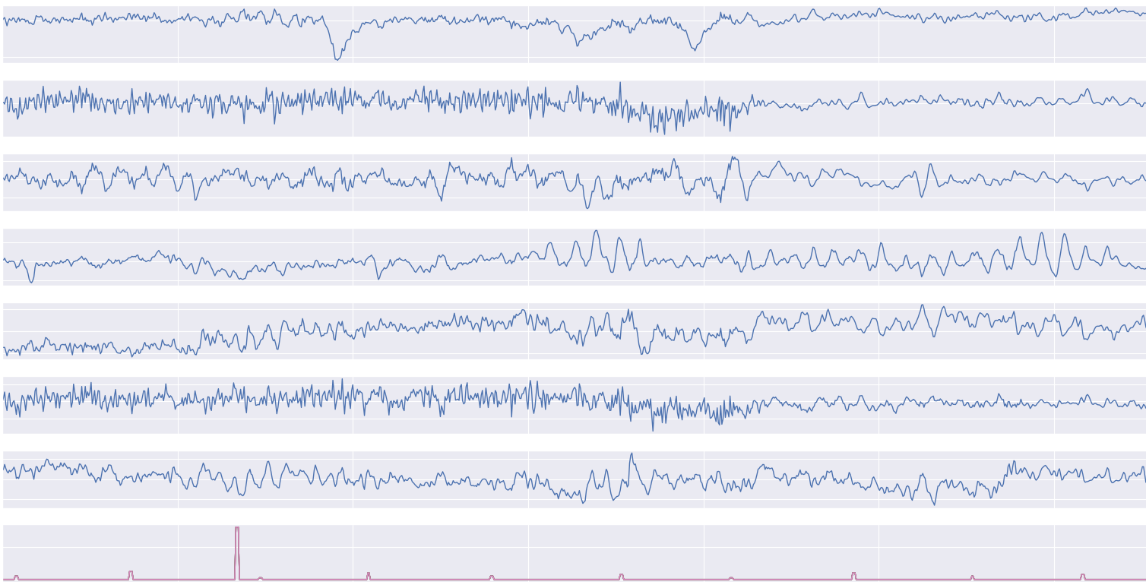
Graph BSS Results Semi-synthetic EEG data
Also possible with Graph Power ICA:
Power ICA
Graph Power ICA
0
1
2
3
t[s]
4
5
6
0
1
2
3
t[s]
4
5
6

Slide 11
Graph BSS Results Semi-synthetic EEG data
Events clearly extractable:
Power ICA
Button push
Visual stimulus
0
1
2
3
t[s]
4
5
6

Slide 12
Agenda
Understanding the basis of Source Separation via an intuitive example-driven approach
Discussion of experiment design
Graph Blind Source Separation
Graph Blind Source Separation results
Summary of major outcomes
Problems and future research

Slide 13
Summary of major outcomes
Question 1: What is ICA?
Question 2: How to compare algorithms?
Question 3: Which algorithm performs best? What happens with noise or outlier?
Question 4: How to robustify algorithms?
Question 5: What is Graph Signal processing / Graph BSS?
Question 6: Outcomes of Graph Signal processing?

Slide 14
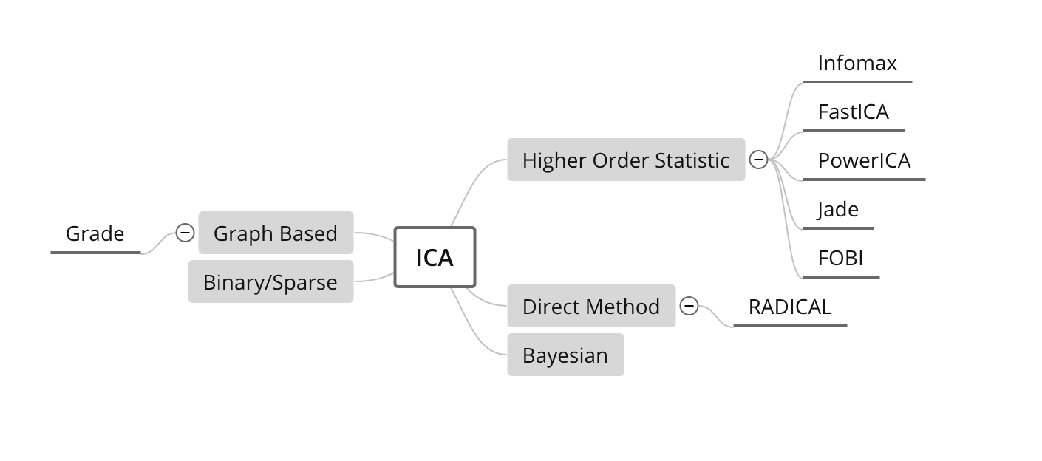
Summary of major outcomes Question 1: What is ICA?
Mathematical concept to extract (independent = non-gaussian) signals from mixed signals
Different approaches to obtain the demixing matrix → 4 algorithms
„ICA tries to decorrelate mixed up signals and find the optimal demixing matrix based on optimizing different measures of independence“
CoroICA

Slide 15
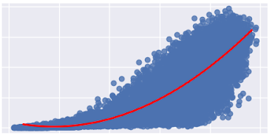
Summary of major outcomes Question 2: How to compare algorithms?
Minimum distance, MSE and SNR
Correlation of different metrics important
„One Metric sometimes provides not the whole information: We need to find how different metrics correlate“
0,8
Power ICA
Graph Power ICA
0,6
0,6
MD
0,4
0,4
Median of MSEs
0,2
0,19
0,0
0,1
0,0
0,2
0,4
0,6
0,8
1,0
Minimum Distance

Slide 16
Summary of major outcomes Question 3: Which algorithm performs best? What happens with noise or outlier?
Monte Carlo run with 10.000 runs: Evaluate metrics
More or less similar with good data (simulated and real EEG data with added artifacts)
Power ICA: quite good with reasonable SNR (~ 20dB), fast and with low variance
Low sample sizes are problematic (< 5000 samples)
Higher noise than 20dB SNR: smoothly becoming worse
All reach breakdown point with one large outlier
„All four algorithms: Good performance on well behaving data but higher noise level or larger outlier cause
failure ➔ Violates assumptions“
Notes:
Low sample size problematisch: central limit theorem → finite variance (ausreißer macht infinite variance)
Gaussian noise (gegen die Annnahmen von ICA)
Ergebnisse machen Sinn: Annahmen über ICA
Robustness nicht gegeben, da asymptotisches Verhalten verändert
Assumptions sagen!
iid, finite covariance, dürfen nicht Gauss sein

Slide 17
Summary of major outcomes Question 4: How to robustify?
Whitening process crucial for algorithms
Different objective functions for some algorithms
Initialization quite important (local maxima/minima)
Within algorithms: quite complicated → model based
What we tried:
Plug-in robustness of covariance estimation in whitening process
Trying out different robust objective functions
Initialize Power ICA with Radical as a global optimizer
„No real improvement: sometimes with noise a bit better, but still low
breakdown point”
Notes:
Robust whitening: probem mit outlier
Problem mit outlier: Unterschied non-Gaussian signals und non-Gaussian outlier
Annahmen verletzen -> ist sinnvoll das es nicht funktioniert
=> Model gibt es nícht her

Slide 18
Summary of major outcomes Question 5: What are Graph Signals / Graph BSS?
Graph signal: Use proximity/similarity between components of the underlying signal
„Graph BSS tries to combine the ICA approach to maximize the measure of independence and the graph signal approach to decorrelate the nodes of the graph”
0
1
2
3
…
N
Notes:
- Wir haben uns damit beschäftigt!

Slide 19
Summary of major outcomes Question 6: Outcomes of Graph BSS?
Monte Carlo with 1000 runs:
Better Blind Source Separation with good signals (low sample size)
Similar with noisy data
Breakdown point with one outlier as well
Problem with graph structure
„Graph BSS is good for low sample sizes and if the graph structure is available. Otherwise similar outcomes as standard BSS”
Real EEG data with artifacts separable!
Notes:
- ICA vesagt: also versagt auch Graph BSS

Slide 20
Agenda
Understanding the basis of Source Separation via an intuitive example-driven approach
Discussion of experiment design
Graph Blind Source Separation
Graph Blind Source Separation results
Summary of major outcomes
Problems and future research

Slide 21
Problems and future research
Problems:
Low Breakdown point
High noise dependency
Sample size important for standard ICA
Graph structure estimation: How to find correlation of graph signals?
Covariance estimation in higher dimensions problematic
Time consumption for real time EEG analysis
Future research:
Robust whitening / preprocessing (Robust covariance estimation in high dimensions)
Incorporate noise process and outlier in model for ICA algorithm
Find good graph structure estimation (recent research [Garcia2020])
Notes:
Defusion based vs decorrelation based (-> time and spatial )
- New Outlier & non-Gaussianity measure finden

Slide 22
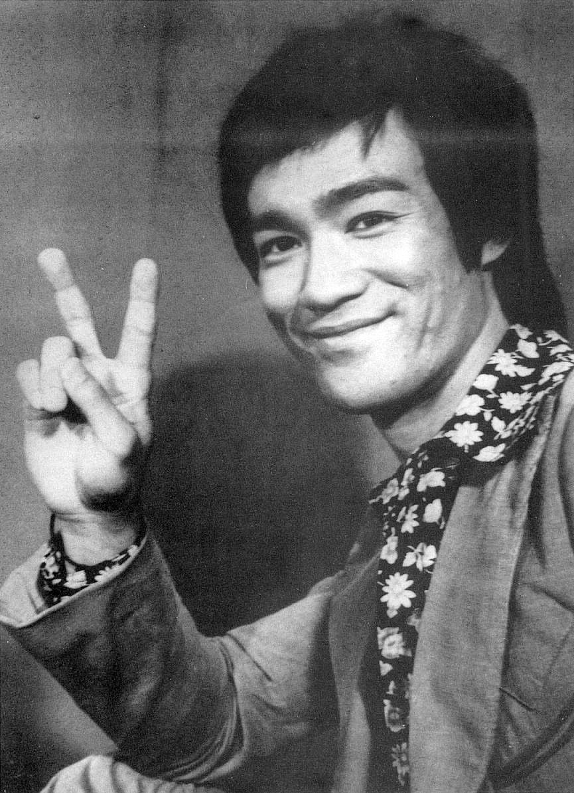
Thank you for your attention!

Slide 23
Sources
Delorme et al.: “Enhanced detection of artifacts in EEG data using higher-order statistics and independent component analysis”, Elsevier 2006
Garcia et al.: ”Blind Demixing of Diffused Graph Signals”, arXiv 2020

